Slide 1

IPL Winning prediction
Using Classification techniques

Slide 2
INDIAN PREMIER LEAGUE
TEAMS | TEAMS
1.CSK | 6.LSG​
2.MI | 7.PUNJAB KINGS​
3.DC | 8.RR​
4.GT | 9.RCB
5.KKR​ | 10.SRH​
The Indian Premier League (IPL) is a global phenomenon that revolutionized the world of cricket. It is a fast-paced, high-energy T20 tournament that brings together top international players and showcases their talent on a grand stage.
Teams in IPL are:

Slide 3
Methods we used:
We had predicted the winning team with the classification algorithm.
Used models in classifications
1.Naïve Bayes
2.Decision Tree Classification
3.Random Forest Classification
4. KNN

Slide 4
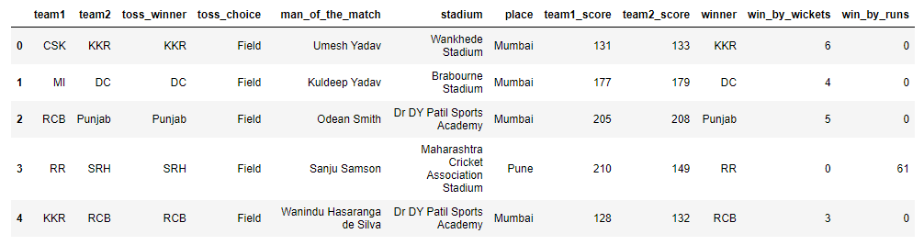

Dataset of IPL
Attribute are

Slide 5
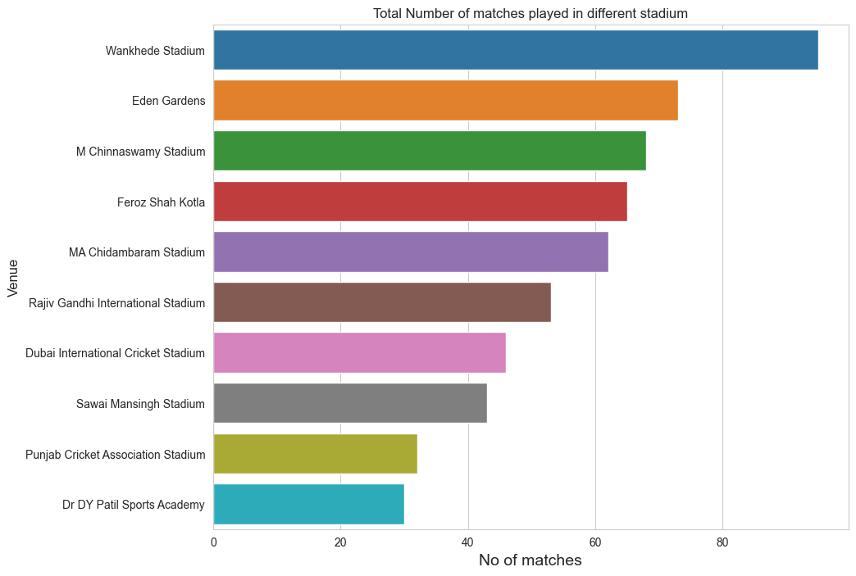
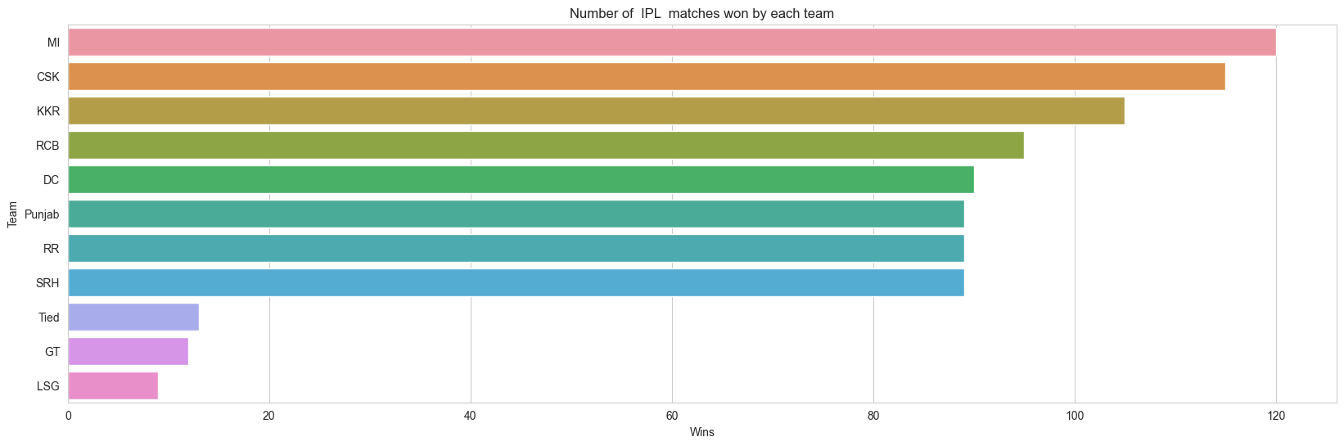
Matches won by each Team
Matches played in each stadium

Slide 6
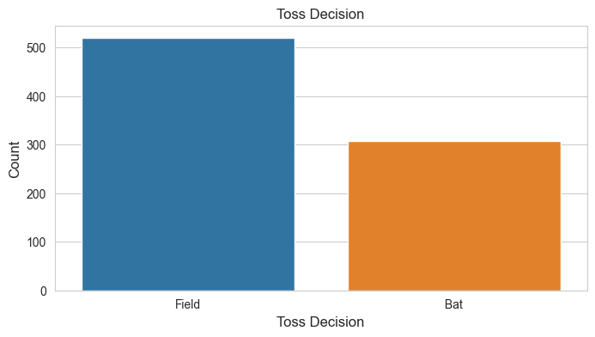
Toss decisions

Slide 7
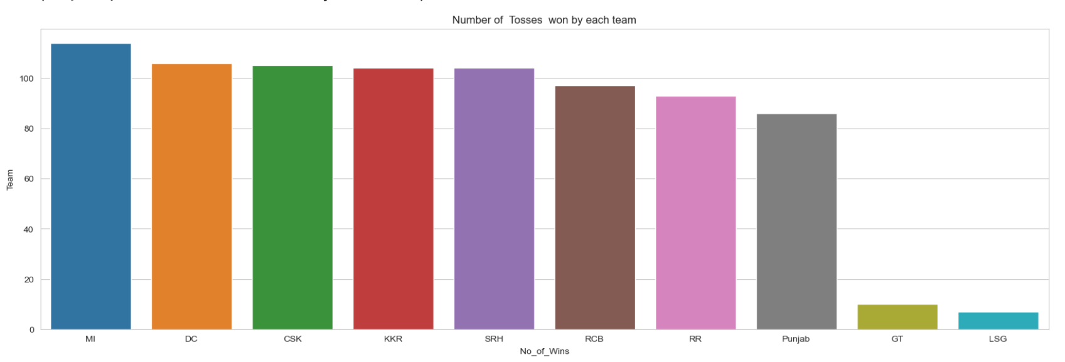
Toss won by each Team

Slide 8
Team score analysis

Slide 9
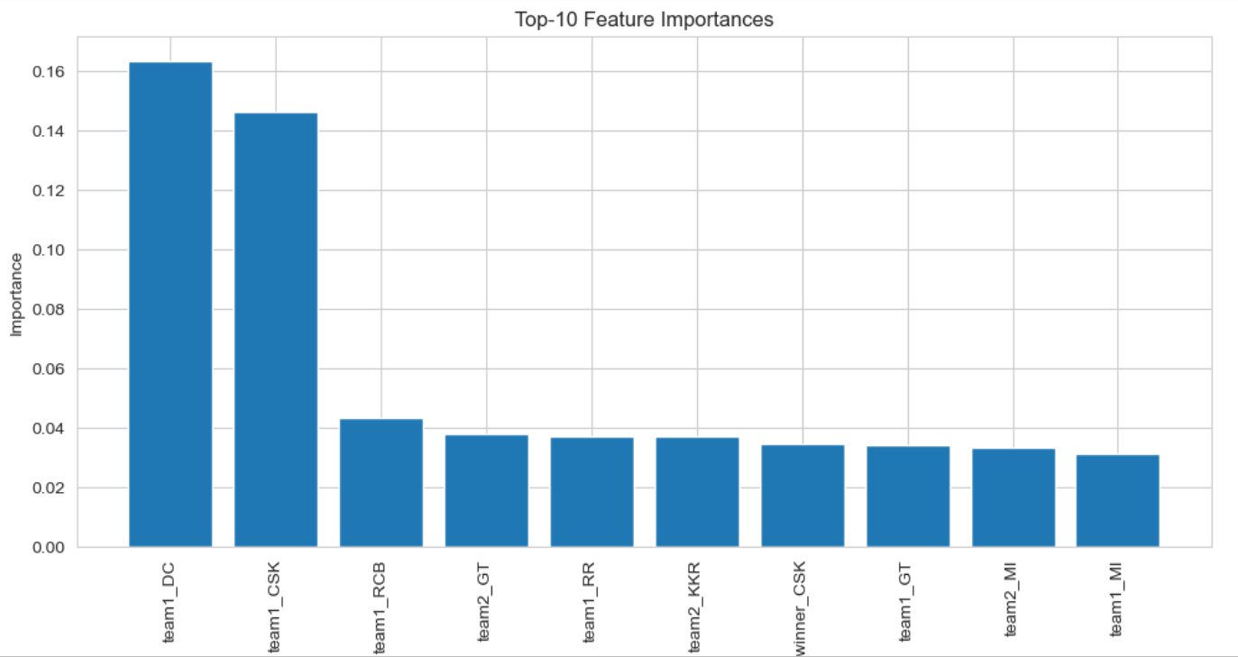
Importance Of features

Slide 10
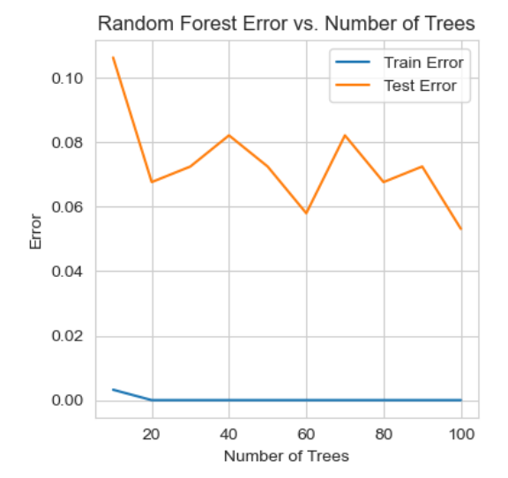
Train error Vs Test Error (Random Forest)

Slide 11
Accuracy
Decision Tree
Accuracy: 0.8647342995169082
Random Forest
Accuracy: 0.9468599033816425
Naïve bayes
Accuracy: 0.3719806763285024
KNN
Accuracy: 0.5700483091787439

Slide 12
Random forest is the best way to predict the winning team and the accuracy for the random forest is 94.68%
Evalution and performance Of Random Forest Classification.
Accuracy: 0.9420289855072463
Precision: 0.8639712918660287
Recall: 0.8194037470897726
F1 score: 0.8349624199665254

